Slide 1
Lecture 3: Overview of Cryptography （II）
An Introduction to Information Security
School of Big Data and Software Engineering, CQU
Fall, 2018

Slide 2
2018年9月，星期一
10
宜高傲
真正不羁的灵魂不会去计较什么，
因为他们的内心深处里有王者般的荣耀。

Slide 3
Quickly Review
Lecture 2
Cryptography
Terminology
Classic Cryptography
Transposition: SPARTAN SCYTALE
Substitution: CAESAR CIPHER
Modern Cryptography
Symmetric Cryptography
Asymmetric Cryptography
Modern
Cryptography
Cryptographic Hash Function

Slide 4




Quickly Review
Question
Alice wants to send a secret message to Bob by using an Asymmetric-Key Cipher. Please help them to select the keys.
Alice’s Private-Key
Alice’s
Public Key
Bob’s Private-Key
Bob’s
Public Key
Alice
Bob
Plaintext
Plaintext
Encryption Algorithm
?
?
Decryption Algorithm
Ciphertext
Ciphertext
Insecure Channel

Slide 5

Outline
1. More Concepts of Cryptography
2. Code Breaking: Cryptanalysis
3. Steganography: Hiding Information

Slide 6
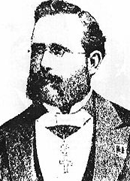
Lecture 3: Overview of Cryptography (II)
1. More Concepts of Cryptography
2…
3…
1.1 Kerckhoff’s Principle
a.k.a., Kerckhoffs' assumption, axiom or law
a cryptosystem should be secure even if everything about the system, except the key, is public knowledge.
密码系统的安全性不在于算法的保密，而在于当对手获知了算法和密文后分析出密钥或明文的难度。
Auguste Kerckhoffs 1835-1903
“The enemy knows the system.”
——by Claude Shannon
Shannon's maxim
What does this mean?

Slide 7
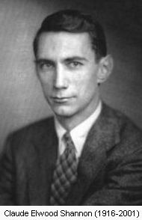
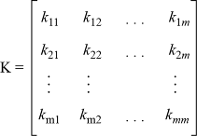
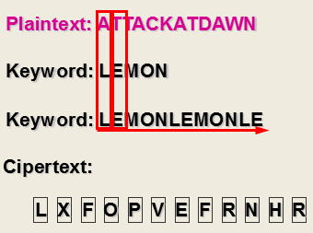
Lecture 3: Overview of Cryptography (II)
1. More Concepts of Cryptography
2…
3…
1.2 Confusion and Diffusion
Confusion: (混淆)
making the relationship between the key and the ciphertext as complex and involved as possible;
Claude Elwood Shannon (April 30, 1916 – February 24, 2001), an American electronic engineer and mathematician, is known as "the father of information theory".

Slide 8
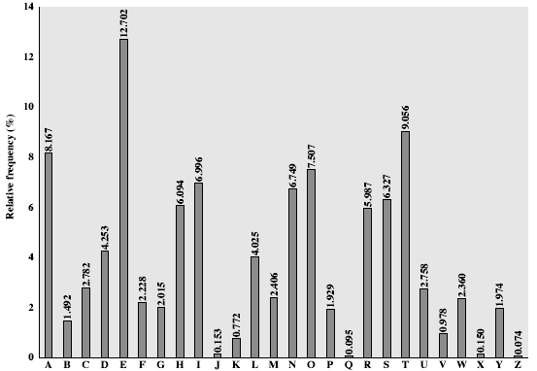
Lecture 3: Overview of Cryptography (II)
1. More Concepts of Cryptography
2…
3…
1.2 Confusion and Diffusion
Diffusion: (扩散)
the property that the redundancy in the statistics of the plaintext is “dissipated“(消散) in the statistics of the ciphertext;
Claude Elwood Shannon (April 30, 1916 – February 24, 2001), an American electronic engineer and mathematician, is known as "the father of information theory".

Slide 9
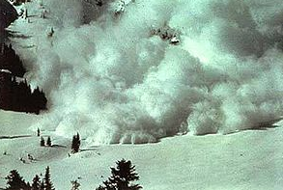
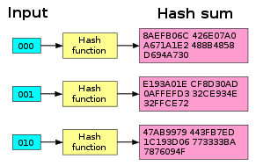
Lecture 3: Overview of Cryptography (II)
1. More Concepts of Cryptography
2…
3…
1.3 Avalanche effect
In cryptography, the avalanche effect refers to a desirable property of cryptographic algorithms, typically block ciphers and cryptographic hash functions.
The avalanche effect is evident if, when an input is changed slightly (for example, flipping a single bit) the output changes significantly (e.g., half the output bits flip)
In the case of quality block ciphers, such a small change in either the key or the plaintext should cause a drastic change in the ciphertext;
雪崩效应

Slide 10
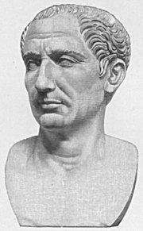
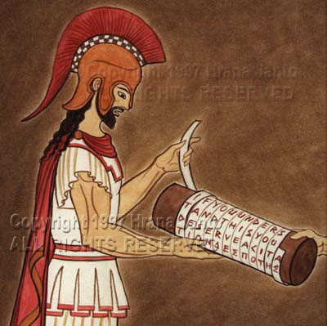
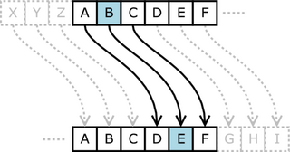
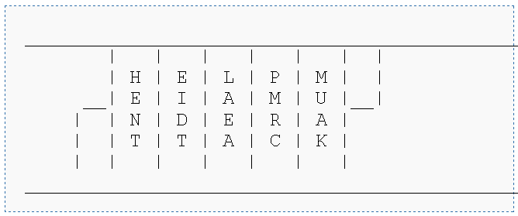
Lecture 3: Overview of Cryptography (II)
1. More Concepts of Cryptography
2…
3…
1.4 Substitution Cipher
A substitution cipher replaces one symbol with another. Substitution ciphers can be categorized as either monoalphabetic ciphers or polyalphabetic ciphers.
Transposition Cipher
A transposition cipher does not substitute one symbol for another, instead it changes the location of the symbols.

Slide 11
Lecture 3: Overview of Cryptography (II)
1. More Concepts of Cryptography
2…
3…
1.5 Block cipher and Steram Cipher

Slide 12
Lecture 3: Overview of Cryptography (II)
1. More Concepts of Cryptography
2…
3…
1.5 Block cipher and Stream Cipher
A group of plaintext symbols of size m (m >1) are encrypted together creating a group of ciphertext of the same size. A single key is used to encrypt the whole block even if the key is made of multiple values.
K
p l a
i n t
e x t
C I P
H E R
T X T
{T,X,T} = E_{K}{e,x,t}
{H,E,R} = E_{K}{i,n,t}
{C,I,P} = E_{K}{p,l,a}
Encryption algorithm

Slide 13
Lecture 3: Overview of Cryptography (II)
1. More Concepts of Cryptography
2…
3…
1.5 Block cipher and Stream Cipher
In a stream cipher the plaintext digits are encrypted one at a time, and the transformation of successive digits varies during the encryption.
K=(k₁, k₂, k₂…)
p l a
i n t
e x t
C
I
P
H E R
T X T
………..
P = E_{K3}(a)
………..
I = E_{K2}(l)
C = E_{K1}(p)
Encryption algorithm

Slide 14
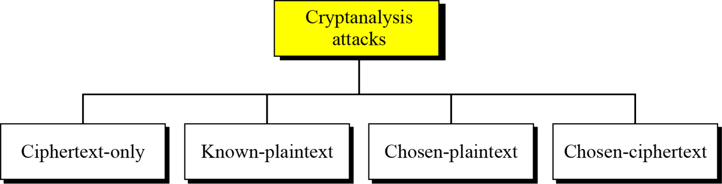
Lecture 3: Overview of Cryptography (II)
1…
2. Code Breaking: Cryptanalysis
3…
As cryptography is the science and art of creating secret codes, cryptanalysis is the science and art of breaking those codes.

Slide 15
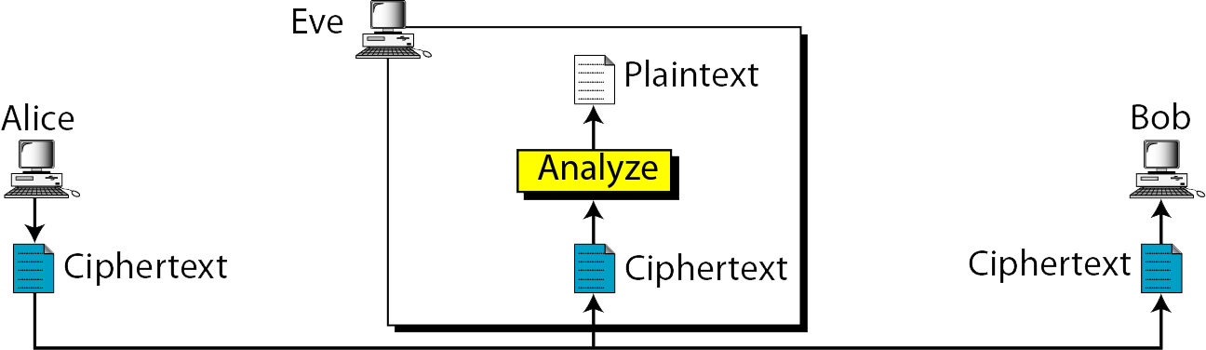
Lecture 3: Overview of Cryptography (II)
1…
2. Code Breaking: Cryptanalysis
3…
2.1 Ciphertext-Only Attack
唯密文攻击
most difficult
need more cipher text to analyze
Brute-force Attack
Statistical Attack
Pattern Attack
……

Slide 16
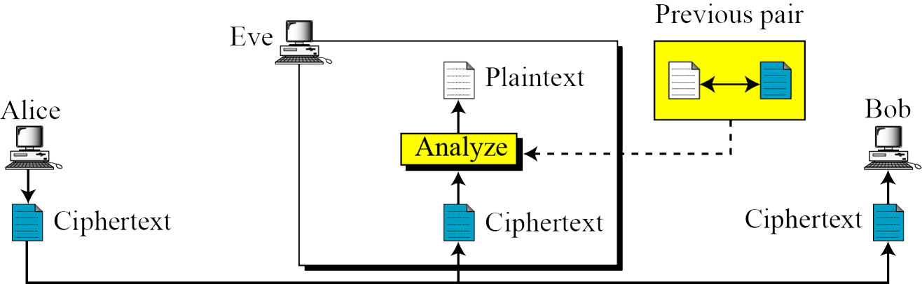
Lecture 3: Overview of Cryptography (II)
1…
2. Code Breaking: Cryptanalysis
3…
2.2 Known-Plaintext Attack
已知部分明文攻击
Heil Hitler
KGFV IOWSAC

Slide 17
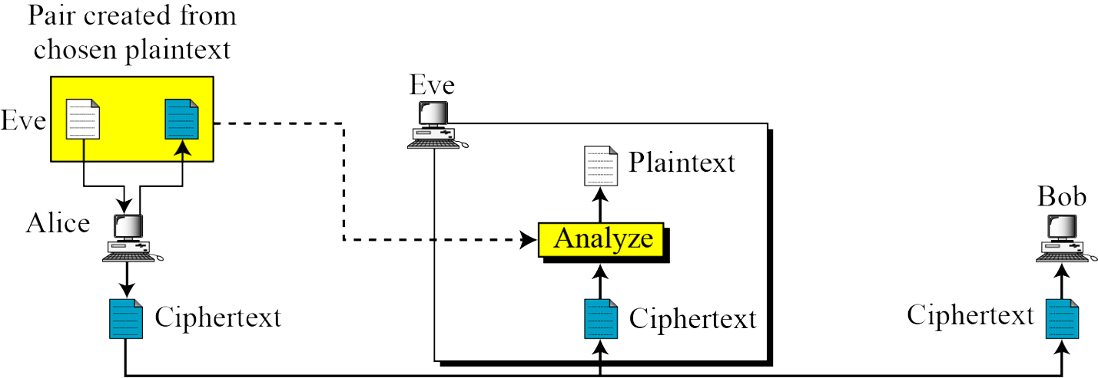
Lecture 3: Overview of Cryptography (II)
1…
2. Code Breaking: Cryptanalysis
3…
2.3 Chosen-Plaintext Attack
选择明文攻击

Slide 18
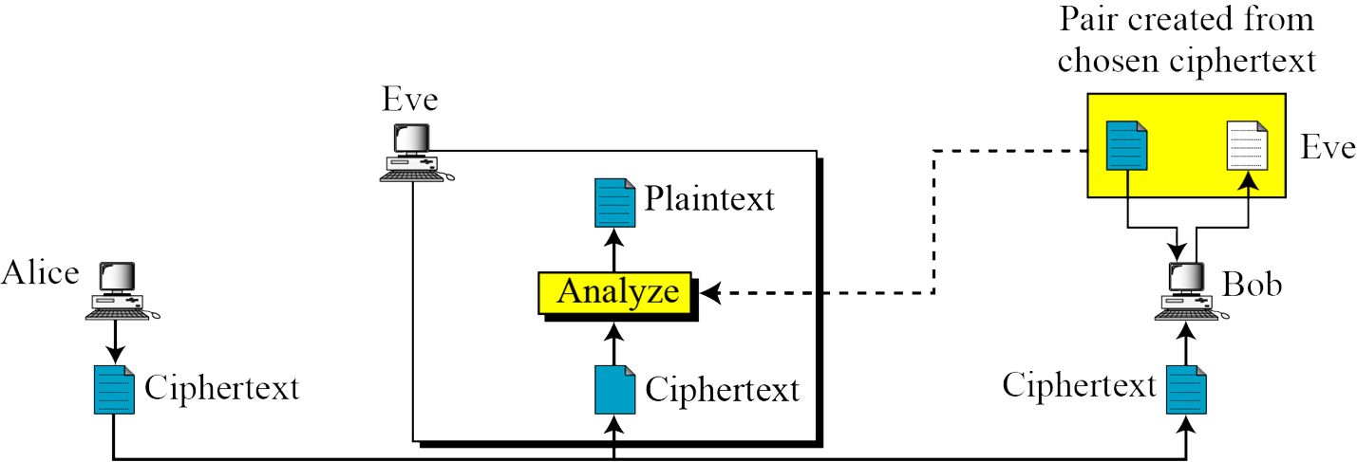
Lecture 3: Overview of Cryptography (II)
1…
2. Code Breaking: Cryptanalysis
3…
2.4 Chosen-Ciphertext Attack
选择密文攻击

Slide 19
Lecture 3: Overview of Cryptography (II)
1…
2. Code Breaking: Cryptanalysis
3…
2.5 Brute-force attack
The code-breaker tries every possible key on a piece of ciphertext until a intelligible translation into plaintext is obtained
On average, half of all possible keys must be tried to achieve success
Key Size (bits) | Number of Alternative Keys | Time required at 1 decryption/µs | Time required at 10⁶ decryptions/µs
32 | 2³² = 4.3 × 10⁹ | 2³¹ µs = 35.8 minutes | 2.15 milliseconds
56 | 2⁵⁶ = 7.2 × 10¹⁶ | 2⁵⁵ µs = 1142 years | 10.01 hours
128 | 2¹²⁸ = 3.4 × 10³⁸ | 2¹²⁷ µs = 5.4 × 10²⁴ years | 5.4 × 10¹⁸ years
168 | 2¹⁶⁸ = 3.7 × 10⁵⁰ | 2¹⁶⁷ µs = 5.9 × 10³⁶ years | 5.9 × 10³⁰ years
26 characters (permutation) | 26! = 4 × 10²⁶ | 2 × 10²⁶ µs = 6.4 × 10¹² years | 6.4 × 10⁶ years

Slide 20
Lecture 3: Overview of Cryptography (II)
1…
2. Code Breaking: Cryptanalysis
3…
2.6 Security of Ciphers
unconditional security (无条件安全)
no matter how much computer power or time is available, the cipher cannot be broken since the ciphertext provides insufficient information to uniquely determine the corresponding plaintext;
一次一密
computational security (计算安全)
given limited computing resources (e.g. time needed for calculations is greater than age of universe), the cipher cannot be broken
Code-breakers must take them in to account:
The cost of breaking the code
The lifetime of useful information

Slide 21
Lecture 3: Overview of Cryptography (II)
1…
2. Code Breaking: Cryptanalysis
3…
2.6 Security of Ciphers
Provable security (可证明安全)
破译密码的难度与数学上某个困难问题的难度相同。
Practical security (实际安全)
包括可证明安全和计算安全

Slide 22
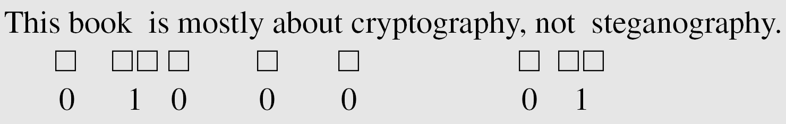
Lecture 3: Overview of Cryptography (II)
1…
2…
3. Steganography: Hiding Information
An overview of Steganography(隐写术，信息隐藏)
Cryptography, a word with Greek origins, means “secret writing.” However, we use the term to refer to the science and art of transforming messages to make them secure and immune to attacks.
The word steganography, with origin in Greek, means “covered writing,” in contrast with cryptography, which means “secret writing.”
Example: covering data with text
视频

Slide 23

Lecture 3: Overview of Cryptography (II)

Slide 24
Lecture 3: Overview of Cryptography (II)
Summary
Fundamentals of Cryptography
Kerckhoff’s Principle
Transposition and Substitution
Confusion and Diffusion
Block Cipher and Stream Cipher
Cryptanalysis
Ciphertext-Only Attack； Known-plaintext attack
Chosen-plaintext attack；Chosen-ciphertext attack
unconditional security; computational security
Steganography

Slide 25
An Introduction to Information Security
Thanks for your attention!
Q&A

